Slide 1
Keys to Success: RMI’s Strategies to Achieving Business Excellence
www.rmipc.net
(810) 732-1919

Slide 2
18 Radiologists​
No Hospital affiliation​
Evolving through innovation and change
Subspeciality driven with fellowship trained radiologists in Neuro, Chest, Cardiac, PET/CT, Nuclear, MSK, Abdomen/Pelvis, IR and Breast​
Our
Company
In Business
for
38 Years!

Slide 3
ABOUT US
Started in 1985​
Grew through acquisitions and de novo start-ups​
Vertically integrated from scheduling to pre-auth to payment estimation to billing to IT and Marketing​
Have grown to be the largest, privately held, physician owned outpatient radiology group in the state of Michigan with 10 imaging centers​
Have 220 nonphysician employees and 18 radiologists​
Today we service approximately 15,000 medical professionals in the state with these 10 centers

Slide 4
LOCATIONS

Slide 5
Quality Matters
To compete against the mega players in healthcare, outpatient imaging must be agile and capable of interacting with as many systems as possible.
To achieve quality metrics imaging centers must develop in house knowledge around systems that allow for these interactions to occur.​
Delivering tools to not just the radiologists, but to the entire team, allows the team as a unit to be more efficient and successful.

Slide 6
Dr. Hicks‘
Keys to Success
Dress for success
Stay healthy
Get a good education
Protect your brand and keep your facilities fresh
Build strong relationships with everyone that touches your business. this includes vendors, bankers, employees, patients, and doctors.

Slide 7
Dr. Hicks‘
Keys to Success
Cont.
Stay ahead of the curve or be the curve
Constantly reinvent yourself to stay fresh and relevant to your customers
Learn from your competition or others in your field and take those lessons home and put them to work
Treat your employees like family so that they also feel pride of ownership in the company you are building

Slide 8
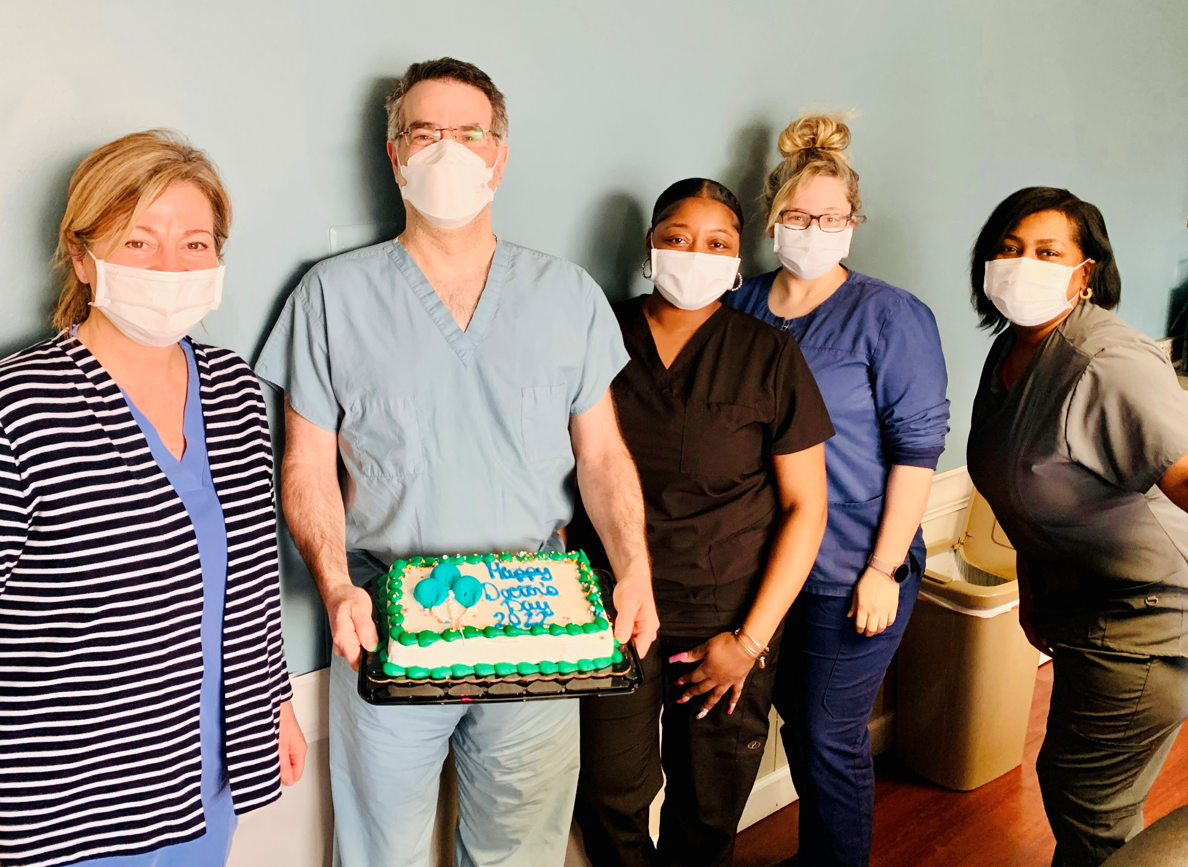
Talent Remains
Key to our Success

Slide 9
Investing in Our People
Annual Biometric screenings
Volunteer opportunities to get involved in RMI communities
Offering advancement and training/educational opportunities to all staff levels.
Supporting and uplifting our employees during challenging times.
Celebrating anniversaries, birthdays, personal and professional achievements, and so much more!
Prioritizing the importance of mental health in the workplace with a dedicated team able to offer on-site mental health services free of charge to all employees, along with personal and professional mentorship & coaching.

Slide 10
REMEMBER, AS IN ANY ENDEAVOR, THE PURSUIT OF EXCELLENCE IS THE PATH TO SUCCESS.
"Quality is never an accident; it is always the result of high intention, sincere effort, intelligent direction, and skillful execution; it represents the wise choice of many alternatives."
- William A. foster

