Slide 1
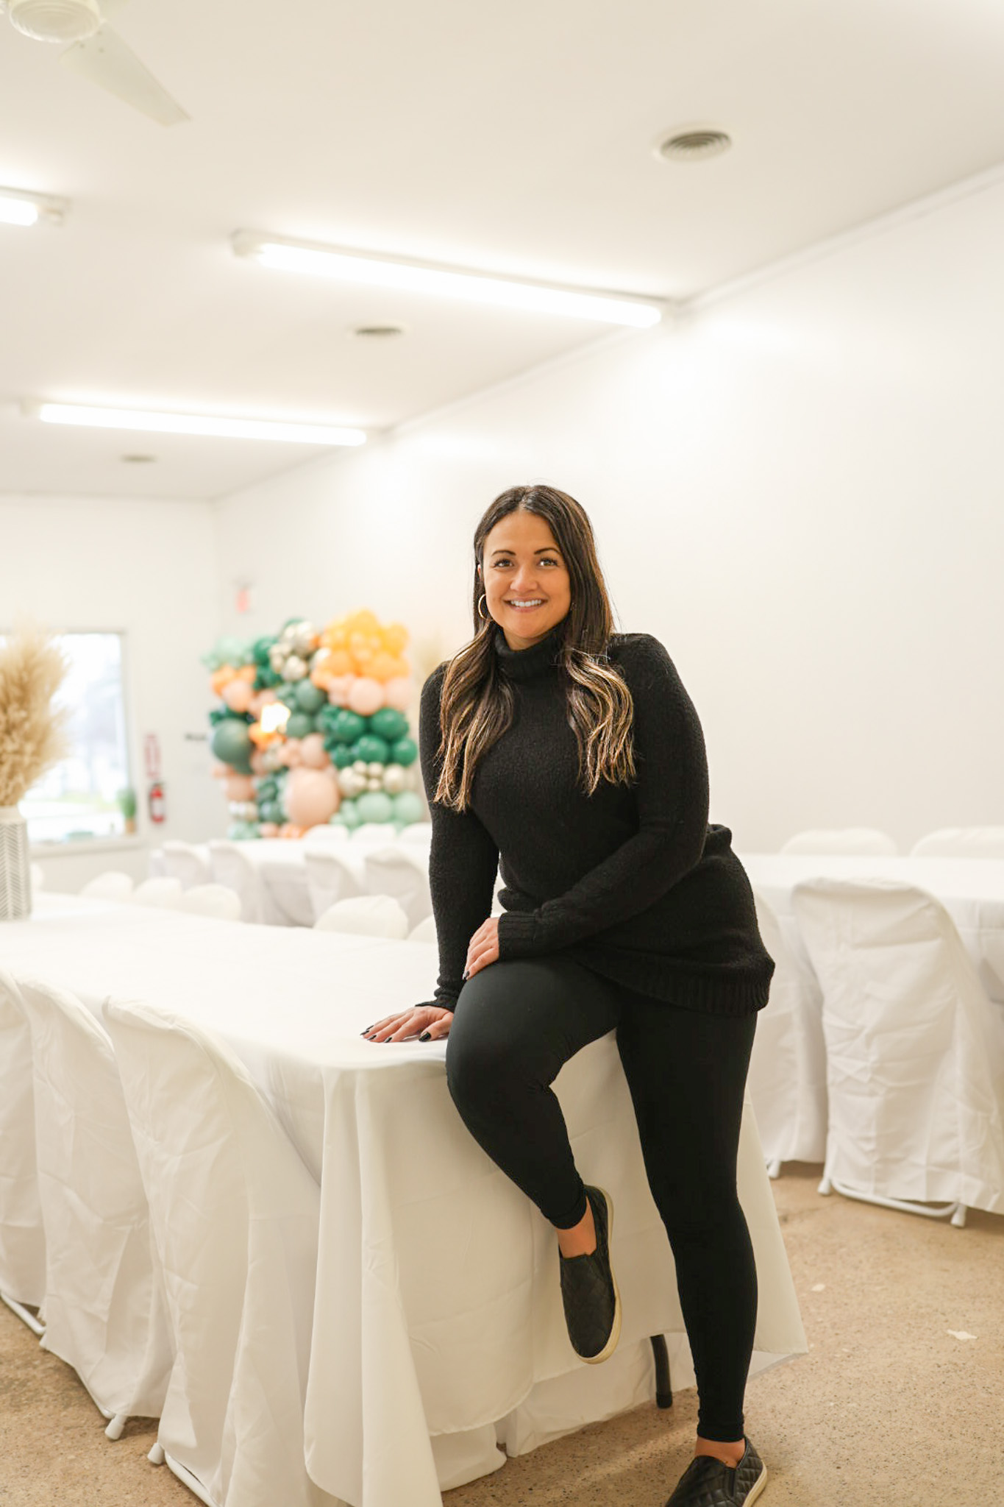
Nicole Rumbold Owner of: The E Co 11500 N Saginaw St Clio, MI 48420

Slide 2
Introduction Branding Capturing your audience Insights How can we help your business?
Agenda

Slide 3
Introduction

Slide 4
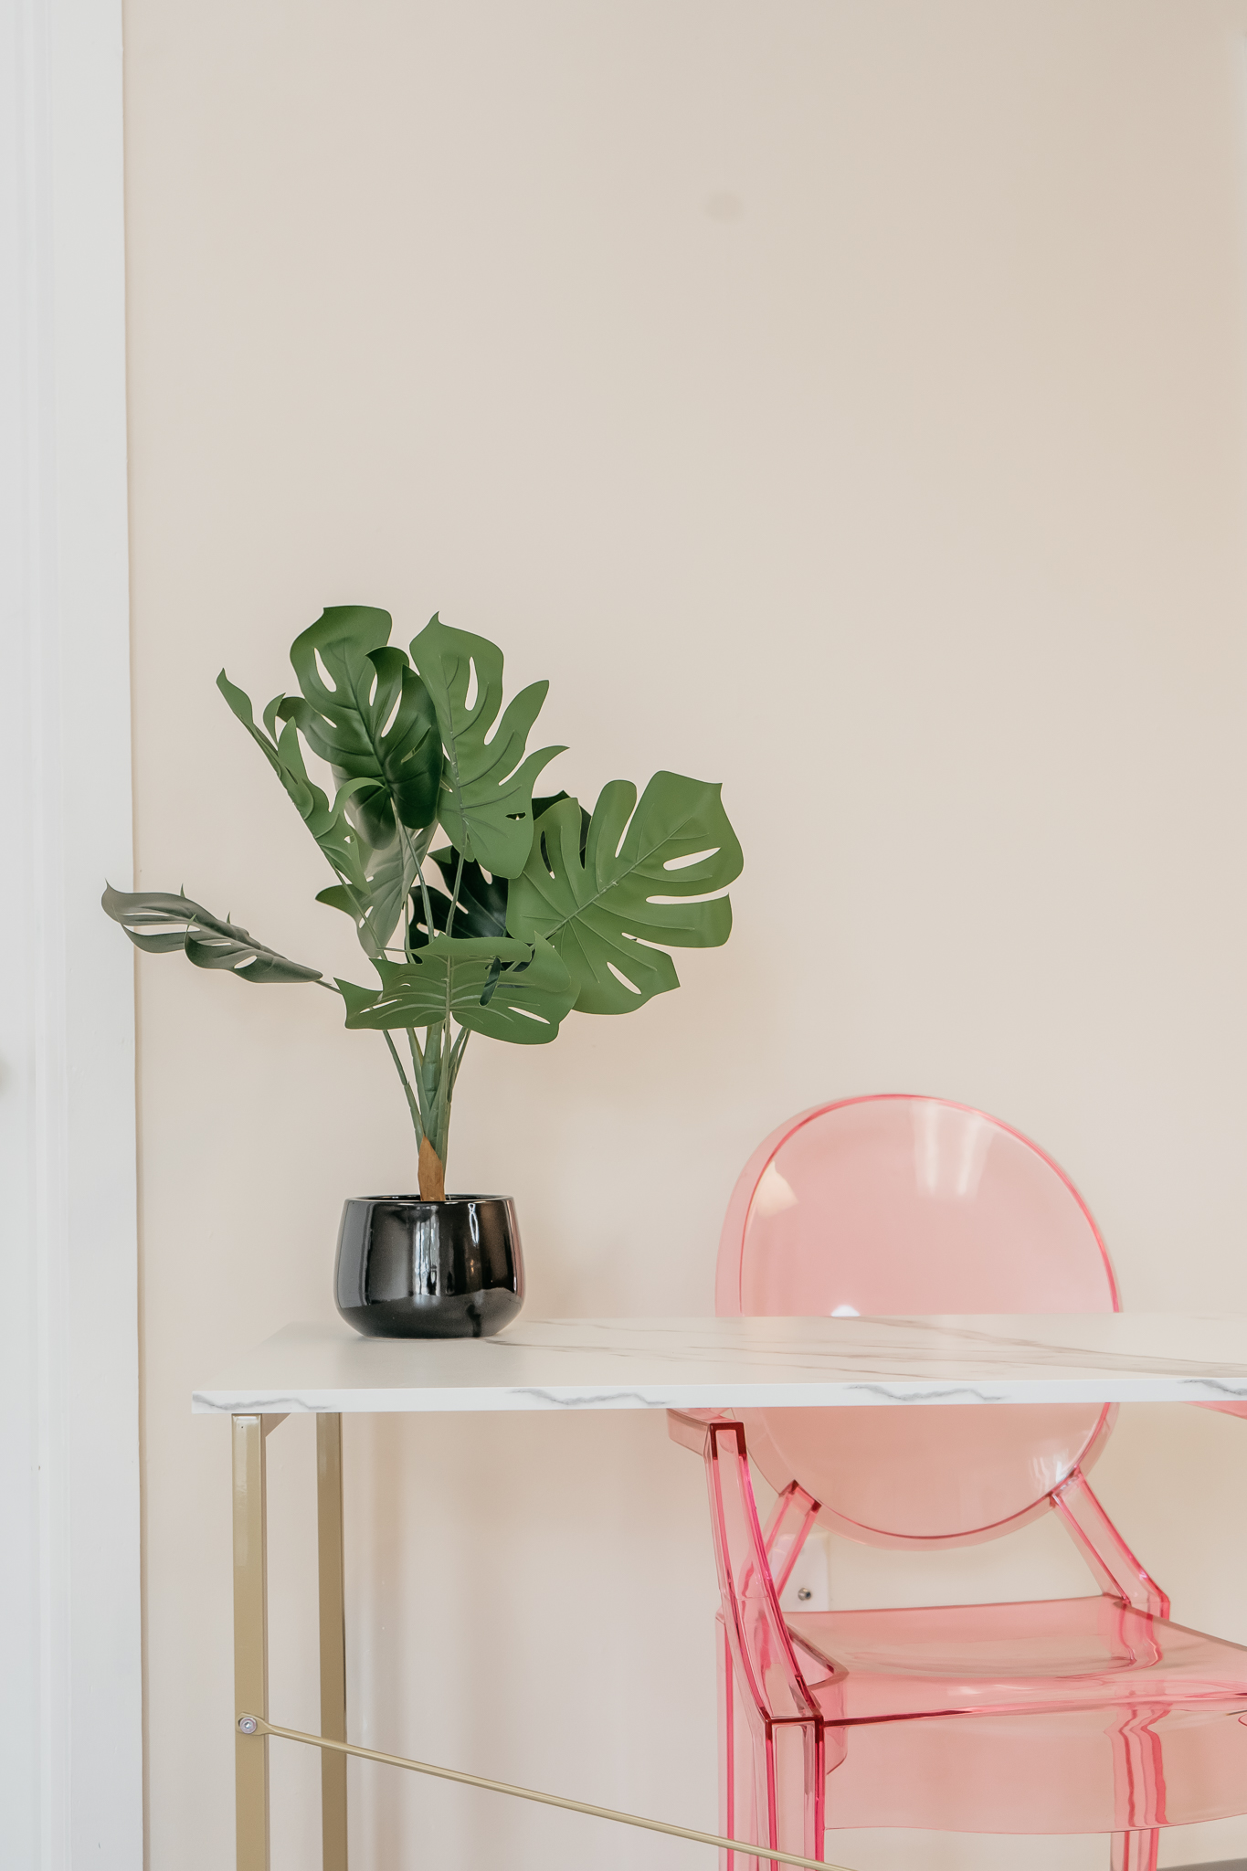
Bachelor’s Degree in Marketing, Public Relations & Healthcare from University of Michigan-Flint
Started The E Co at the Montrose location in September 2022
Opened the other side as a venue in October 2023
Moved to the Clio location in June 2024
The E Co is a photography studio that rents out by the hour to photographers who need to rent the studio to take pictures of their clients
We have paper backdrops, different set ups to shoot content for your business
Realtor full time, in the process of starting my own brokerage
***Studio photos by: Luminous Lux Studios

Slide 5
Branding

Slide 6
Branding Branding is the process of creating a distinct identity for a business in the minds of its target audience and the general public. It's more than just a company's name and logo, and it includes visual identity design, mission, values, and tone of voice.
Use the same fonts/color schemes/logo
What makes you stand out? What does your business provide that other businesses do not?
How can you collab with other businesses to increase the brand awareness of your own business? Community over competition says a lot about your business
Consistent brand presentation across all platforms can increase revenue up to 23%
89% of consumers will buy from a brand they follow on social media
80% of consumers are more likely to purchase when brands offer personalized experiences

Slide 7
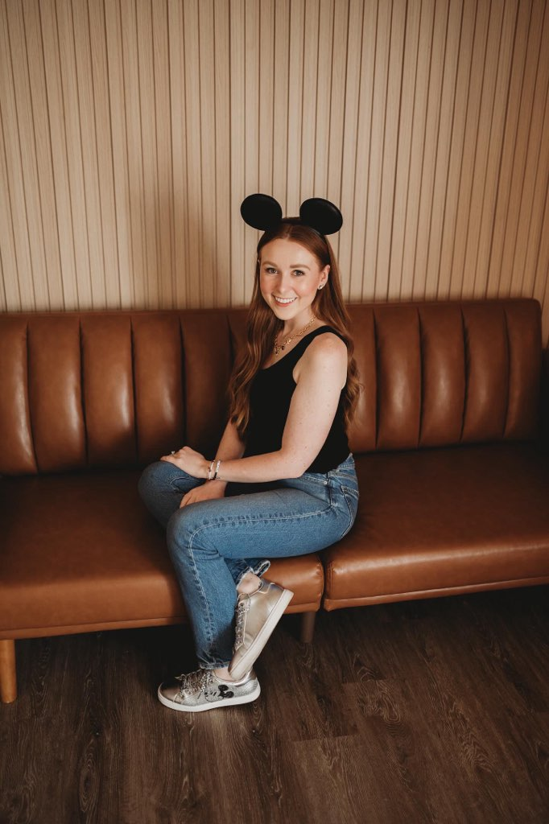
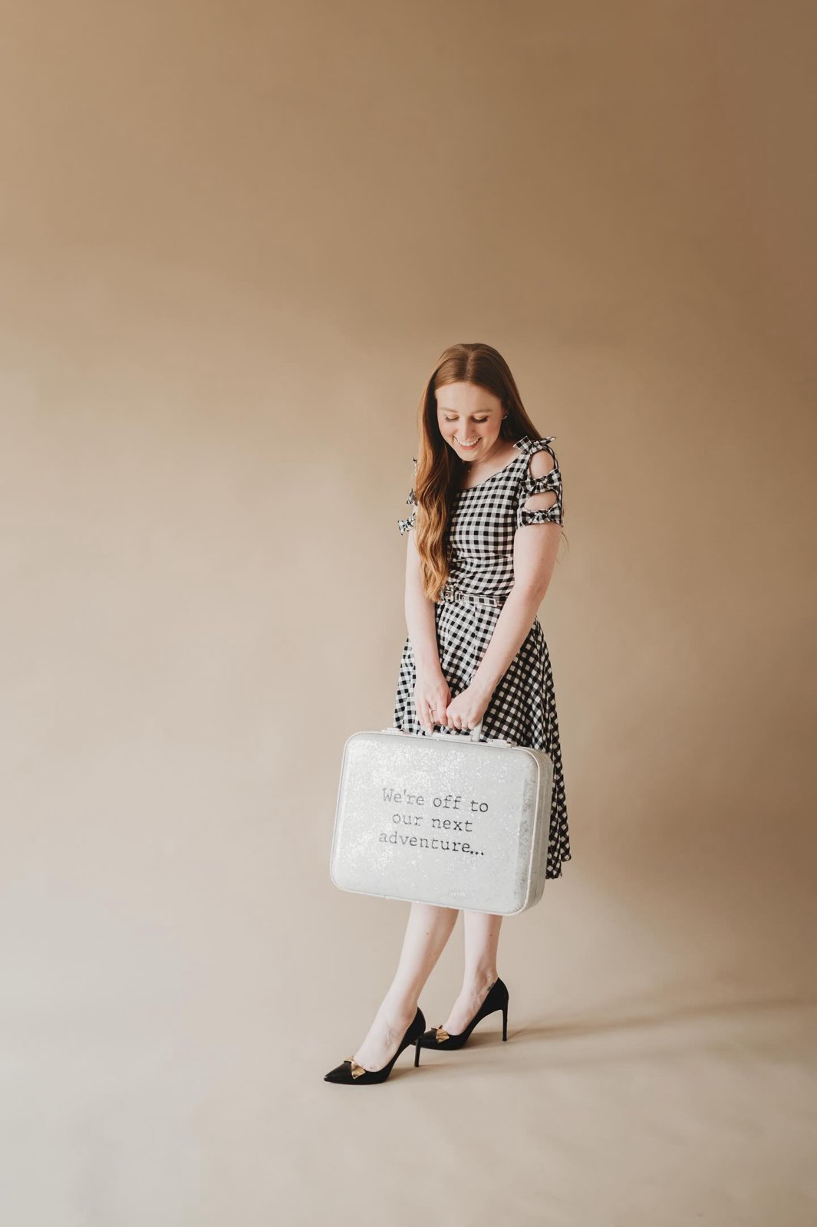
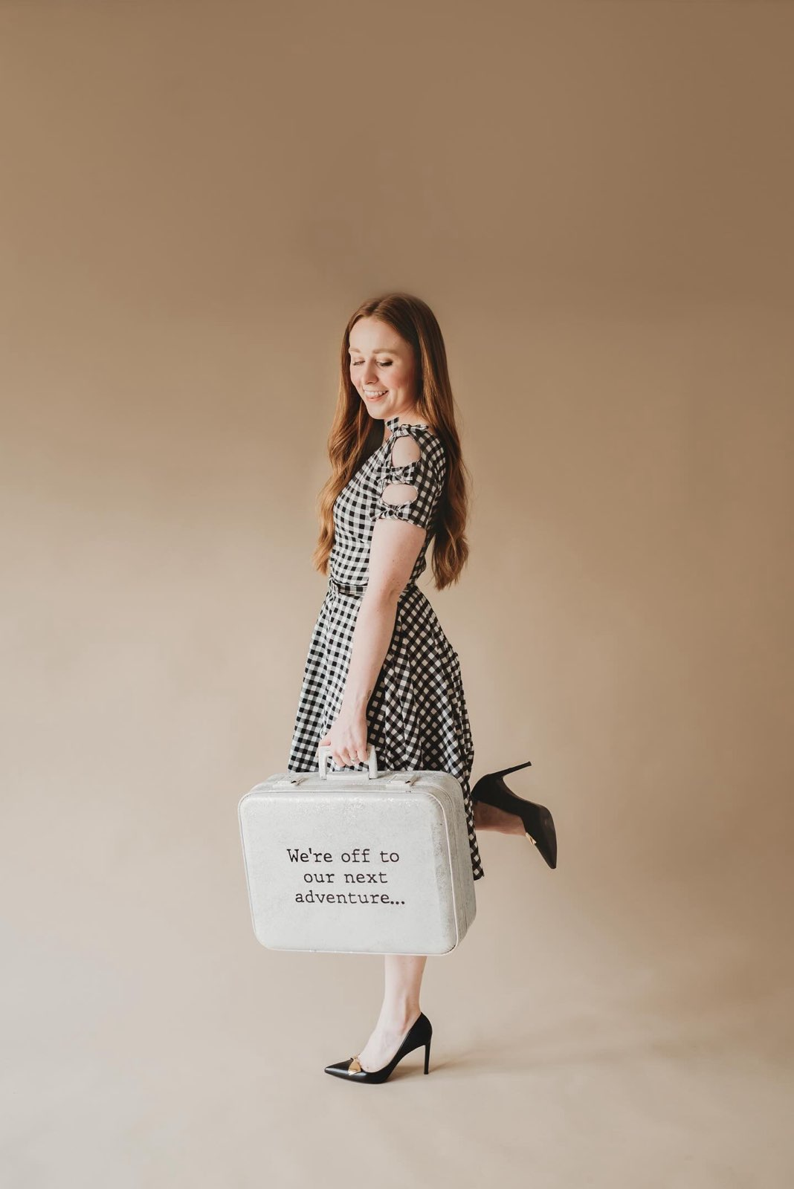
Branding Session
***Photography by Blue Stone Photography

Slide 8
Capturing your audience

Slide 9
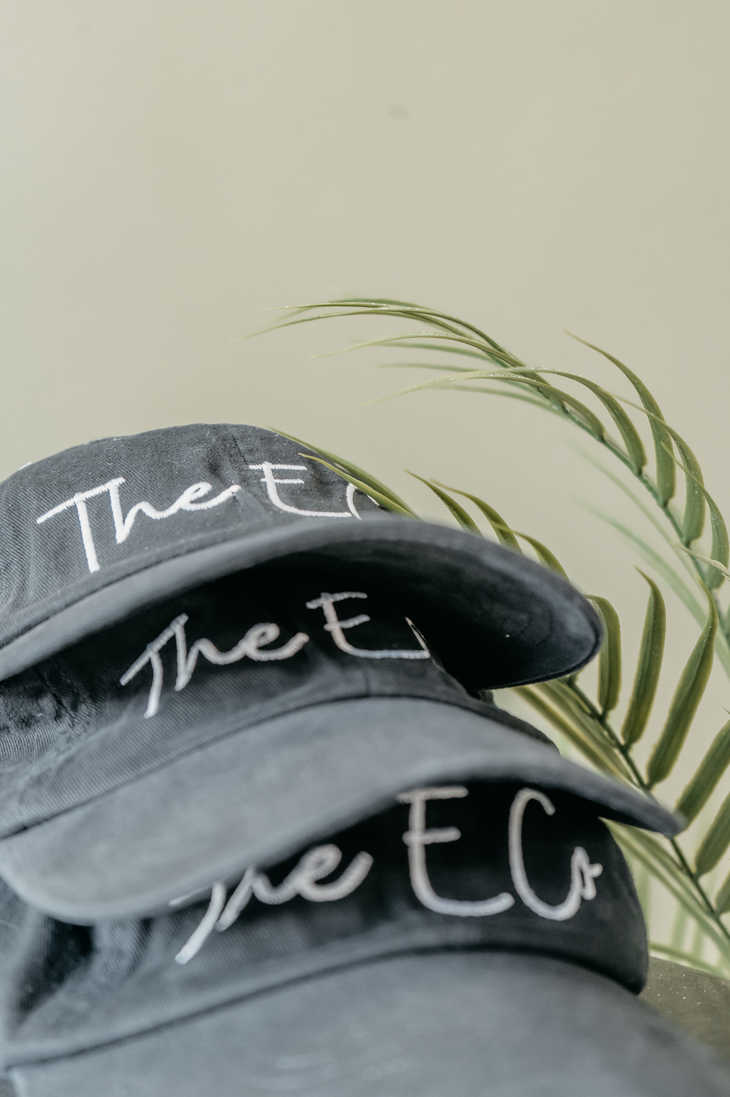
Capturing your audience
Consistency Is Key
Incorporate Your Company’s Logo Into Everything You Do
Create Mission and Vision Statements for Your Brand
Use insights for targeting the right audience
#hashtags – use hashtags familiar with your branding
Use #hashtags to find your audience
Check in your location EVERY time you post
Make sure you are on Google! SEO is great for finding businesses
Use Trending Audio when creating reels
Identify your target market and make your content geared towards that group (depending on the business)
***Studio photos by: Luminous Lux Studios

Slide 10
Content Ideas To Post On Social Media
1. Remind People Who You Are, How You Got Started 2. Make a behind the scenes reels 3. Share a Personal Story – people relate to personal 4. Tell People What You Sell 5. Share a success story 6. Share stats about your industry 7. Repost old posts – new followers haven’t seen them 8. Post a how to or tutorial of your business building 9. Talk about mistakes not to make as a new business owner 10. Host a Poll - ask people what new products/services do they want to see 11. Ask people how they found you 12. Feature another local business on #smallbusinesssaturday 13. Host a Giveaway 14. Tell People to Sign Up On Your Email List (share the link) 15. Give away a coupon 16. Host a Sale 17. Remind People How To Buy Your Products or Services 18. Share a Quick Tip for business owners 19. Make a post and ask people to share a picture while using your product or service 20. Go live and have the audience ask questions
***Studio photos by: Luminous Lux Studios

Slide 11
Insights

Slide 12
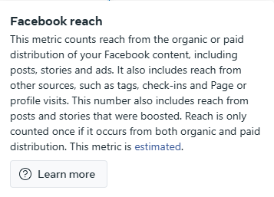
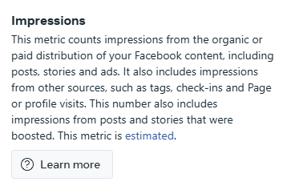
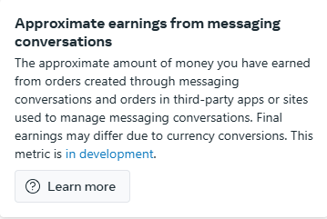
Social media insights are analytics that come from monitoring and analyzing data about social media activity. They can include factors like: Engagement metrics, Audience demographics, Content performance, Conversion rate, and Cost per click (CPC)

Slide 13
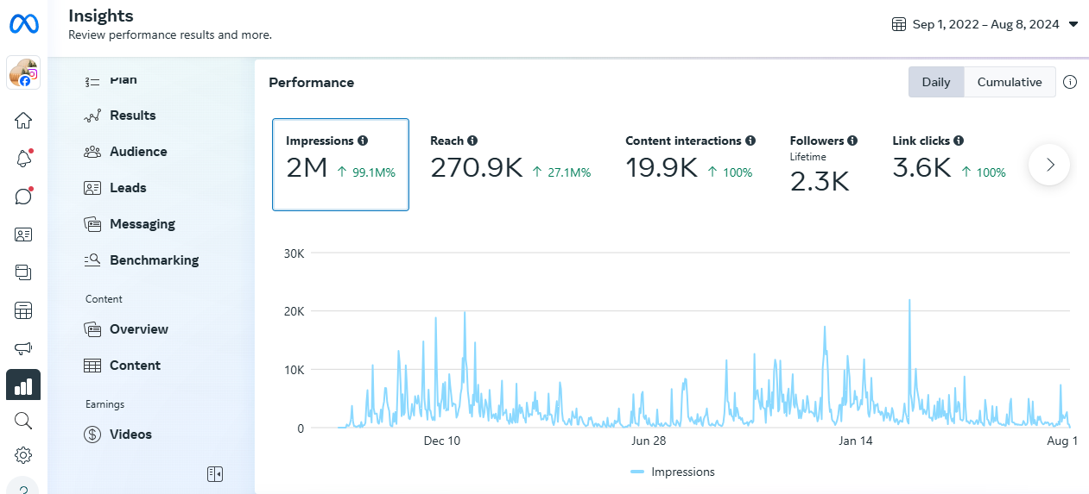

Slide 14
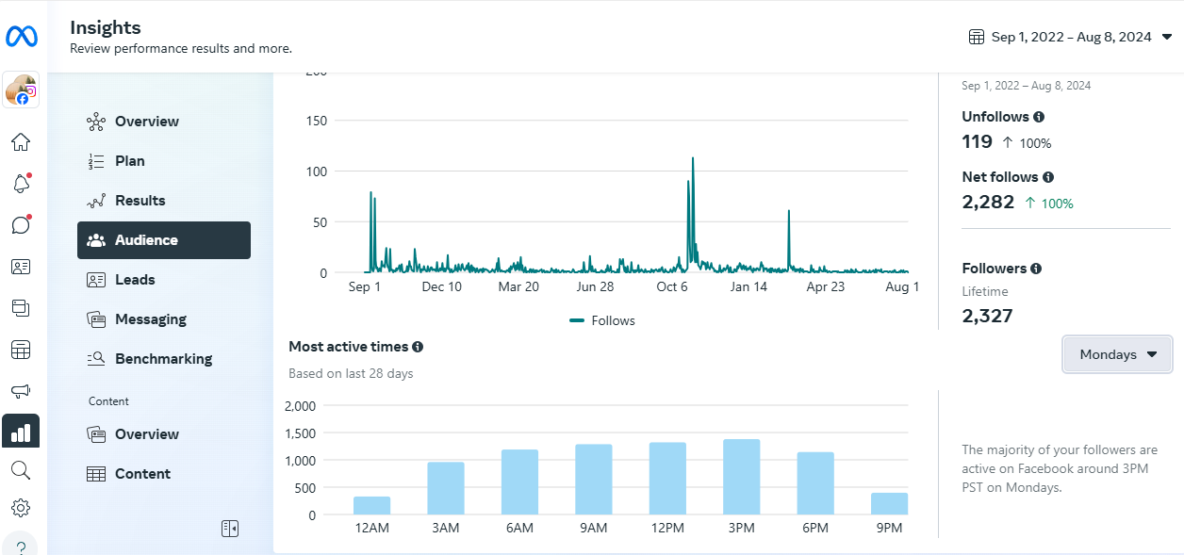

Slide 15
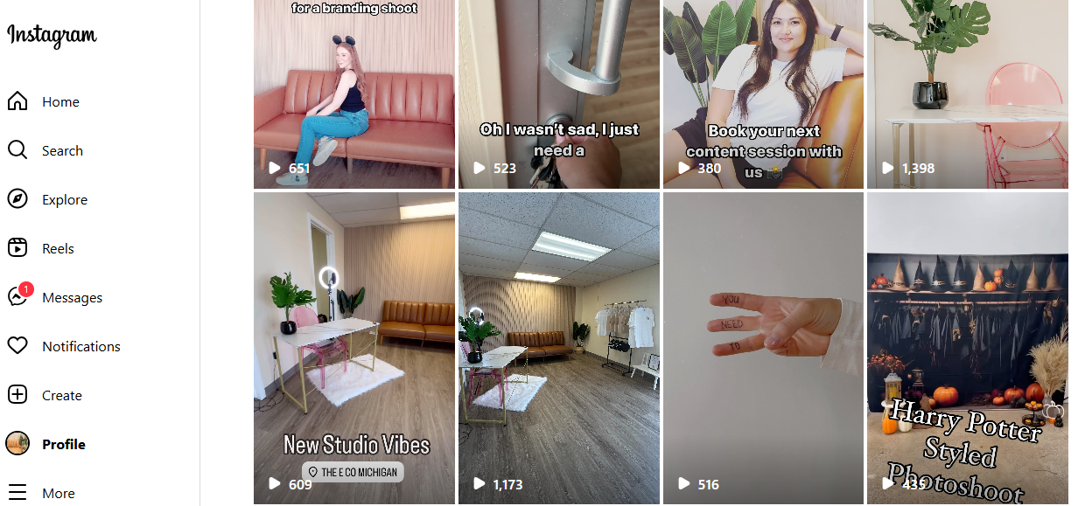

Slide 16
How can we help your business?

Slide 17
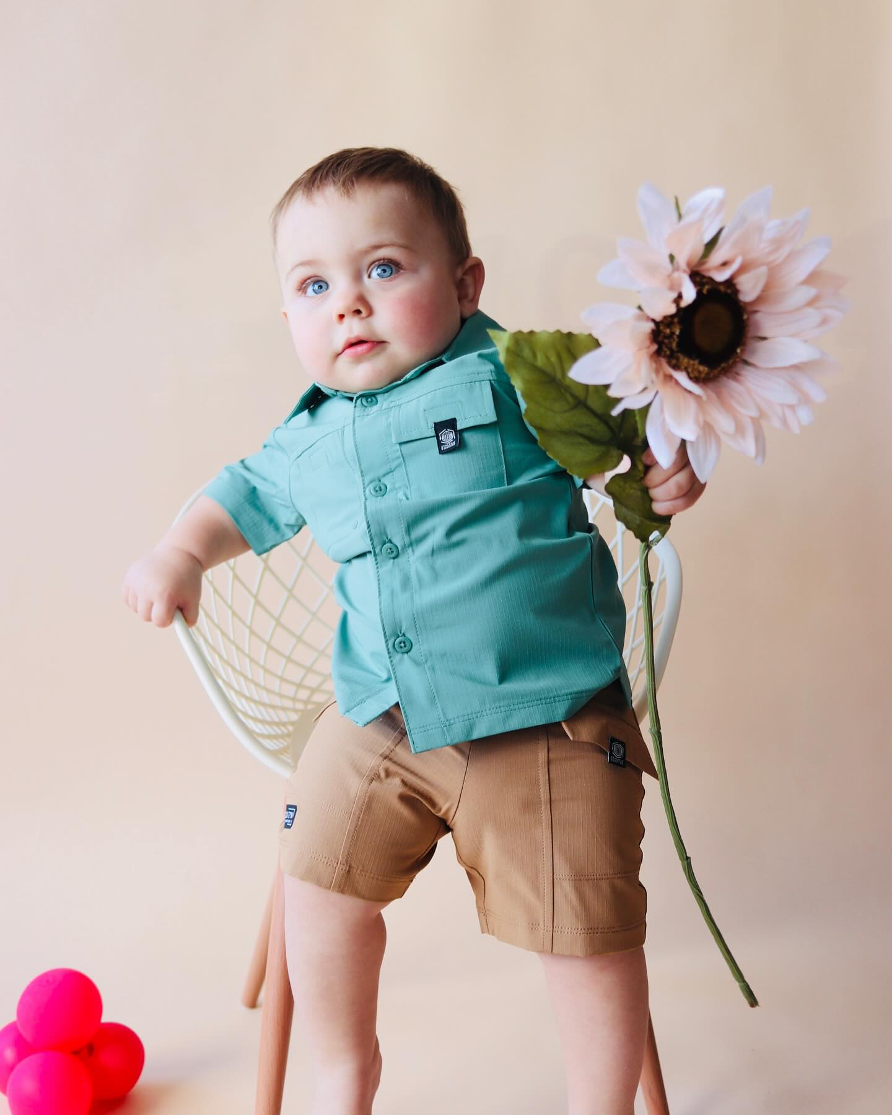
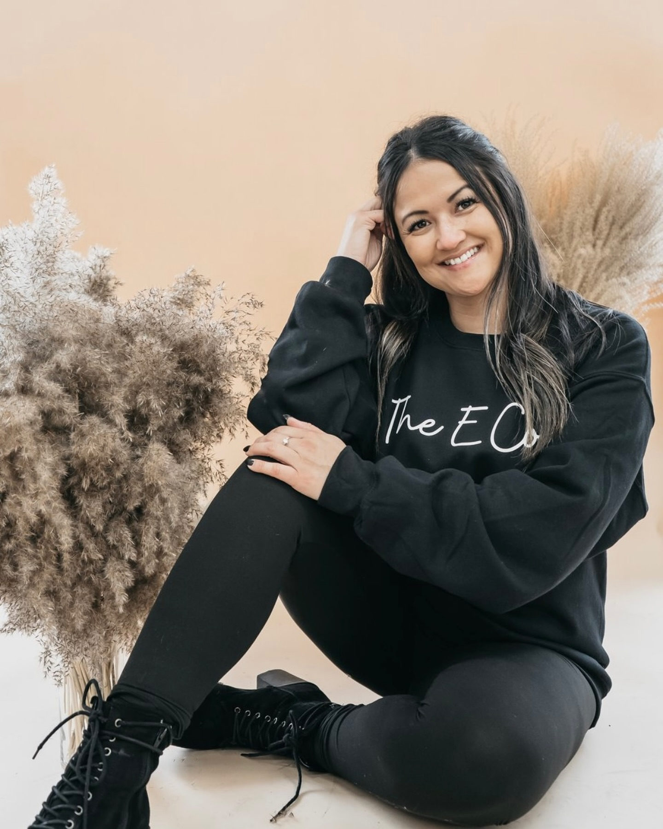
How can we help your business?
Our studio provides content creators who can help you create content and post on your page for a monthly fee
We have photographers who can make a branding package of pictures for you to post on your social media
We host social media classes
We host content days
Like and Follow our page!
@theecompanymichigan

Slide 18
TikTok is expected to reach over 2 billion users in 2024.
TikTok is the most frequently used app worldwide, with Android phone users spending an average of 34 hours per month on the platform.
36.7% of TikTok users are 18-24 years old and account for the largest share of TikTok’s advertising audience.
TikTok is the second-most used video entertainment app by monthly active users.
27.4% of US Instagram users are between 25 and 34 years old.
Instagram’s engagement rates are four times higher than Facebook (0.60% to 0.15%), but engagement has become more competitive each year.
Total spend on social media advertising is projected to reach $219.8 billion in 2024.
It's now projected that $255.8 billion of total social media ad spending will be generated through mobile by 2028.
Total ad spend growth is anticipated at 6.1% in 2024.
Social media ads account for 28.8% of all digital advertising spend.
Businesses put around 8.7% of their total revenue towards their ads budget.
Facebook is the most-used platform by marketers worldwide (89%). Instagram sits in second place (80%).
As of Q3 2023, Facebook is the largest online social network in the world with roughly 3.05 billion monthly active users.
The average American spends about 31 minutes per day on Facebook.
Almost a quarter of Facebook users in the US are between the ages 25-34

Slide 19
Thank you!
Nicole Rumbold
Owner of:
The E Co
810.836.9110
info@theecompany.org
www.theecompany.org

