Slide 1
How To Connect with Today’s Workforce

Slide 2
In this increasingly dynamic and competitive job market, attracting top tier talent has become a priority for companies looking to stand out and thrive. Newer professionals, with their energy, creativity, and digital skills, are essential assets for any company seeking to innovate and grow in today’s business landscape.
While seasoned professionals offer a wealth of experience and trade & true best practices. Having a diverse workforce allows for an environment of learning, mentoring and trust, as employees can grow from one another’s abilities
Employers must ask if their company is ready to attract newer professionals, and are your season veterans willing and ready to mentor?
Known fact, millennials or Gen Y (Individuals born between 1981 and 1996) are now the largest generation in the workforce. It’s estimated in 2025, this group will make up around 75% of the global workforce.
How can your company attract top tier talent when hiring younger workers?

Slide 3
What is the current workforce seeking?
WIIFM or What’s in it for me? This has changed. No more, 30-year company men & women
Talent wants evidence of a cultural fit – What is meant by culture?
Talent wants to have a purpose at work, feel engaged and empowered.
Talent is concerned about the -bigger picture and their role within it.
Individuals want to be developed, and they want this to align with personal development.

Slide 4
What Area’s Are Employer’s Falling Short
Job Descriptions
Onboarding & Initial Training
Providing Sense of Purpose or Belonging
Continuous Professional Development & Engagement.

Slide 5
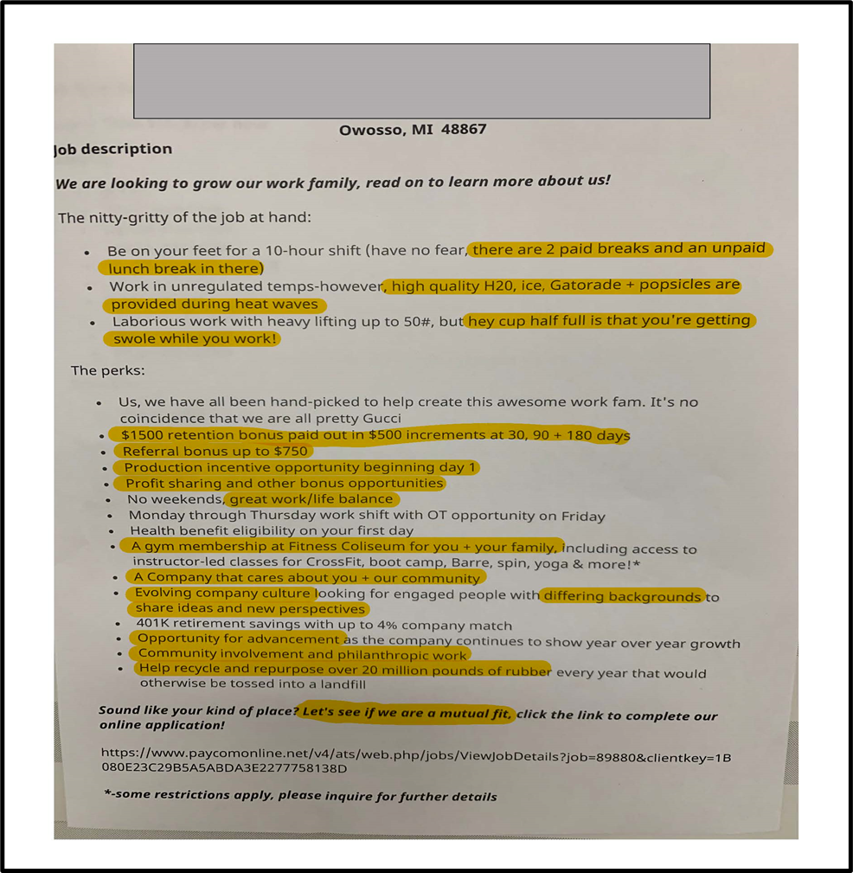
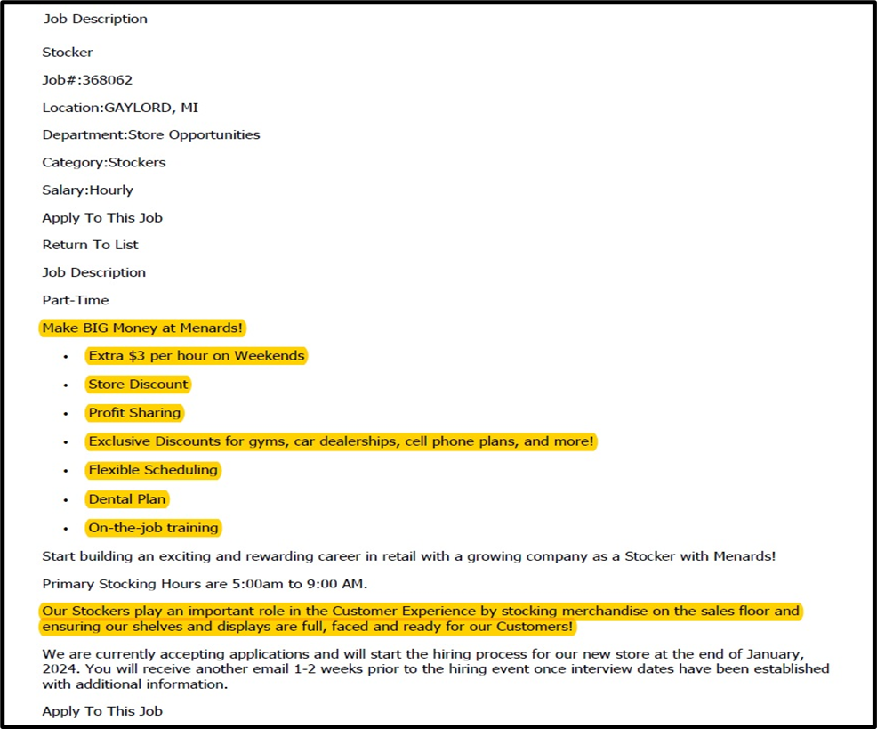

Slide 6
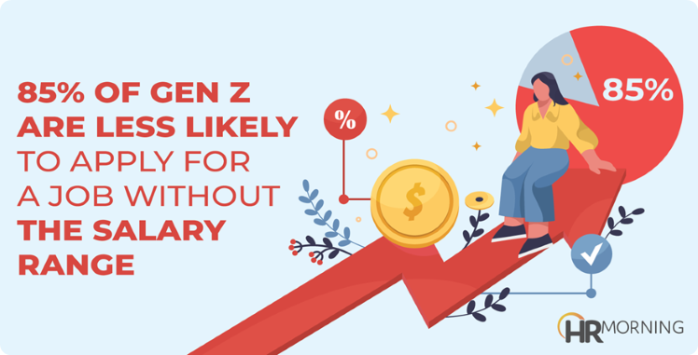
Job Descriptions
Unclear Expectations – Ambiguous descriptions of responsibilities and Qualifications can leave potential confused
hop Talk or Business Jargon – Spell out and explain acronyms. What is CMS – Don’t assume every will know what this mean. If you need someone to update your CMS system, explain that you are looking for someone who can enter data into a content management system, which is used to manage content on the website, called CMS.
Outdated Requirements – Listing outdated technical requirements that are not essential for the role can deter qualified candidates.
Onboarding & Initial Training
Information overload – to much to retain too soon
Lack of role clarity – Not defining responsibilities & expectations
Poor communication – Lack of Check-in & Feed Back
Not addressing personal/individual needs – specific learning styles & Experience level
Not having an onboarding plan in place – Clear tried and true roadmap, defining milestones and key objectives

Slide 7
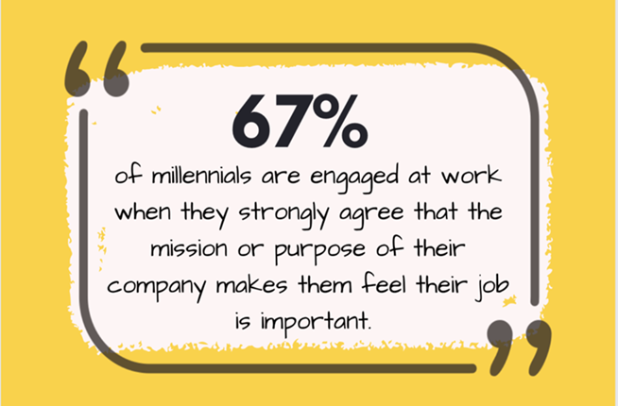
Providing Sense of Purpose & Belonging
Open Communication Channels – creating opportunities for feedback, ideas, and concerns
Team Building Activities – Encourage collaboration and connection among colleague, through regular team meetings, team projects, and shared experiences.
Professional Development Opportunities – Provide training, mentorship programs, and career advancement paths
Continuous Professional Development & Engagement
Mentorship and Coaching programs – Pair employees with experience positive colleagues for guidance, feedback, and career advice.
Job Rotation and Cross-Training – Provide opportunities for employees to gain experience in different roles to broaden skillset
Performance Feedback and Goal Setting – Regularly provide constructive feedback to employees, linking performance goals to professional development opportunities.

Slide 8
How to Connect With Todays Workforce
We’re in a trend of increased expectations for “good” jobs. A good job is not simply one that pays a little above minimum wage: these positions are everywhere and plentiful. Good jobs promise a future and make individuals feel valued. Career jobs pay living wages, have predictable hours, visible skill and wage progression, and most importantly foster respectful relationships with supervisors and co-workers.
Bad jobs communicate that the employer doesn’t care whether an employee stays or goes.
Communicate Opportunities for Career Progression:
Individuals may have had multiple short-term, dead-end jobs before you hire them. If you are hiring for a long-term position, make that very clear from the start. If you do not make this clear, job seekers may pre-maturely leave your position for one that explicitly mentions growth opportunities.
Build Positive Relationships Prior to Hiring:
Individuals need to be able to imagine themselves in your workplace, doing your jobs, and working with your people. Employment tours and job shadowing are effective in helping candidates visualize themselves in a role.
Ensure A Positive First Day Reception:
Entering a new workplace should resemble the start of a new relationship. Make announcement of the new hire’s first day, have team leaders and managers ready to greet with introductions and first week snapshot information. Also, provide a welcome small welcome gift. One of the biggest mistakes an employer can make is assuming that new employee is ready and will figure things out. It’s a signal that you don’t care.
First impressions are crucial to retention!

Slide 9
Assign New Hires A Mentor:
Employees need to learn both job skills and the informal culture of the workplace. If you leave it to chance, some employees will figure things out, and others will struggle.
Mentors can provide information and integration into the social
life of the workplace.
Don’t leave onboarding of lower-level workers to chance!
Communicate and Explain Expectations Clearly:
Every workplace has both formal and informal rules around expected behaviors. Many people discover these rules by keeping their head down and looking around. But some rules – such as no cellphones – may seem self-evident or unreasonable to younger workers. There is nothing wrong with a rule that makes sense, but it’s the employer’s job to communicate not
only the rules, but why they make sense.
Create A Racially Equitable Workplace:
Various Minority groups, people of color, women and immigrants have experienced discrimination in past jobs, schools, and public places, and are worried they will experience it again in your workplace. Employers need to pay attention to the basics, such as race and gender discrepancies in pay, shifts and hours, and job assignments.
Foster A Climate of Respect and Dignity for Everyone:
Tolerating disrespect in any form drags morale down, reduces productivity, and encourages turnover
Create A Culture Were New
Employees Can Ask Questions:
Today’s workforce are often hesitant to speak up and ask for help. They fear failure. Allow younger workers to ask questions and be clear that it is productive to do so
Understand Non-Work Lives:
Younger Employees typically live different lives than more established workers. Some have children, some rely on public transportation, and some are in school, or their children are. Successful supervisors and employers understand that they must learn the reality of their younger workers and non-work lives.

Slide 10
How Can GST Michigan Works! Assist Local Employers With
Recruiting, Buy-In and Retaining of Talent?
Customized Talent Solutions for Your Business Needs
Fresh Strategies to Attract & Retain Your Top Talent
Posting, Promotion & Distribution of Featured Jobs
Offset Cost of New Hires with On-the-Job Training
Incumbent Worker Training to Avert Layoff
Developing Registered Apprenticeship Programs
Specialized Regional Industry Grants
Work Opportunity Tax Credits (WOTC)
Information Regarding Fidelity Bonding
*Approval subject to funding availability, state and local policy and eligibility requirements.
Workplace Excellence Career Focus Series
Depend-ability | Communication-ability
Present-ability | Adapt-ability
Reason-ability | Respect-ability
Work-ability | Transition-ability

Slide 11
Going PRO Talent Fund
The Going PRO Talent Fund makes awards to employers to assist in training, developing, and retaining current and newly hired employees. Trained funded by the Talent Fund must be short-term and fill a demonstrated talent need experienced by the employer. Training must lead to a credential for a skill that is transferrable and recognized by the industry.
Since 2014, GST Michigan Works! has assisted:
500 or more employers have secured a Going PRO Talent Fund Award
4,000+ incumbent workers upskilled
1,200+ newly hired workers trained
150+ apprentices trained
Do you qualify to apply for Going PRO?
Do you have a need for skill enhancement?
Do you have a physical presence in Michigan?
Are you a non-government private entity?
Are you complaint with all state tax obligations, such as: corporate, sales, use, withholding, and unemployment?
Are you willing to participate under the program’s guidelines?
For more information regarding the Going PRO Talent Fund, please visit: www.Michigan.gov/talentfund

Slide 12
ADVANCING EMPLOYERS | ENHANCING TALENT
GST Michigan Works! is here to assist the employers of Genesee, Huron, Lapeer, Sanilac, Shiawassee and Tuscola Counties. Helping Businesses survive and thrive in today’s global economy. Our goal is to help strengthen our region and state’s economy by assisting you to select, hire, train, develop and retain a high-performance workforce.
GST Michigan Works! Support
We will assist you to find and retain top talent.
We will assist in rating and prescreening applicants.
We will customize value added services to meet your unique needs aimed at finding and retaining talent, reducing your employee turnover and increasing your Return-On-Investment (ROI)
Mike McGee
Business Solutions Professional
Genesee County
810-233-5974 – Office
810-820-0736 – Cell
mmcgee@gstmiworks.org

